Slide 1

Word Embeddings and A Very Simple Word Embedding Based Model
Matthew Engelhard
Notes:
Last time, we talked about the bag of words approach to natural language processing, or NLP
in which we first define a vocabulary of words that are relevant to our prediction task,
then convert each text passage in our dataset into a feature vector
that can be used in our predictive model by counting occurrences of each vocabulary word in that passage.
This strategy is simple yet powerful, and is highly effective for many biomedical NLP tasks
Today, however, we’ll talk about an important limitation of this approach
along with a different approach to NLP that overcomes that limitation
by converting words into vectors that encode their meaning
For now we’ll simply suppose that it’s possible to do this – to assign words to a numeric vector that encodes their meaning –
and take a look at a very simple approach to text classification based on these word vectors
Then, in the next lecture, we’ll take a look at how word vectors are learned.

Slide 2

Problem: our model counts words, but has no understanding of their meaning
gleeful
miserable
merry
euphoric
sorrowful
ecstatic
upset
joyful
down
satisfied
melancholy
happy
depressed
content
sad
unhappy
Goal: predict sentiment (positive/negative)
Notes:
Let’s consider a model that is trying to predict whether a person is happy or sad based on a social media post
This is an example of sentiment classification – we’re trying to determine whether the sentiment in a text passage is mostly positive or mostly negative
We’ll use a bag of words approach to do this, so that for each social media post, we’ll count the occurrences of each word in our vocabulary. Again, the vocabulary is the set of all words we believe are relevant to our prediction task. This can be defined by identifying words that commonly appear in our training set, but it can also be defined using prior knowledge relevant to the prediction task. For this task, we’ll suppose our vocabulary includes all the words shown here on the slide, as well as many others not shown.
During training, our model will learn how strongly each of these words are associated with positive versus negative labels – in other words, happy versus sad posts – in our training set. To us, it is obvious which of the words is positive versus negative, but remember, the bag of words model has no prior knowledge of these words’ meaning – they’re simply features that may or may not be associated with the labels.

Slide 3


To effectively predict sentiment, it would be helpful to understand which words have similar meaning
I am sad
I am miserable
I am sorrowful
I am upset
I am down
training set
I am content
I am joyful
I am merry
I am satisfied
I am euphoric
I am depressed
?
?
?
?
I am unhappy
test set
I am happy
I am gleeful
Notes:
we’ll suppose that the words sad, miserable, sorrowful, upset, and down; as well as content, joyful, merry, satisfied, and euphoric; all appear a number of times in the training set, and so our model is able to learn that the first five of these words tend to be found in posts labeled as sad, whereas the second five tend to be found in posts labeled as happy.
In this training set, however, it just so happens that the words depressed, unhappy, happy, and gleeful are either absent or infrequent, so that the model is not able to learn how these words are associated with positive versus negative sentiment in social media.
Again, for us it is obvious which words are positive versus negative, but it is not obvious to the model, because it has no understanding of these words’ meaning

Slide 4
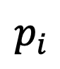
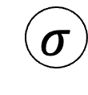
logistic regression: positive / negative sentiment
$$p_{i}$$
probability that sentiment is positive
positive
zero
negative
gleeful
sad
miserable
sorrowful
upset
down
content
joyful
merry
satisfied
euphoric
gleeful
ecstatic
depressed
unhappy
i
am
melancholy
Satisfied
happy
$$σ$$
z_{i}
b₁
b_{M}
x_{i}
“I’m so depressed coach K is retiring…”
“I’m so happy coach K is finally retiring…”
Notes:
Here we see a model that has learned a number of words that are associated with positive sentiment in the training set, as indicated by the orange weights, and other words associated with negative sentiment in the training set, as indicated by the blue weights.
However, the words happy and depressed were not in the training set, so when the model sees a post saying “I’m so depressed coach K is retiring” -- or “I’m so happy coach K is finally retiring”, depending – it’s not sure whether the sentiment is positive or negative.
What would be much better is if, instead of treating “happy” and “joyful” as distinct features, we instead had a model that recognized that these two words are closely related, and therefore that joyful and happy should have similar impact on the predicted probability that the sentiment is positive

Slide 5
We’d like a numeric representation of words that encodes their meaning
miserable
upset
joyful
melancholy
happy
content
euphoric
sad
unhappy
satisfied
merry
ecstatic
sorrowful
depressed
down
gleeful
<- sadder
happier ->
Numeric value indicating whether the word is happy or sad
Notes:
In other words, we’d like to have a numeric value that specifies the degree to which that word in our vocabulary is happy or sad. Then, we can learn how this value is associated with the label, instead of learning how each individual word is associated with the label.

Slide 6
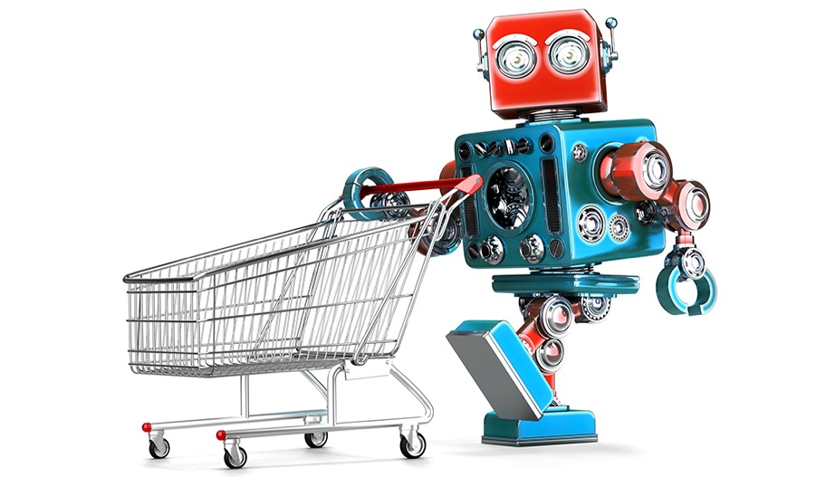
Training a robot to buy groceries
Example from Anand Chowdhury, MMCi 2019
Notes:
To explore this idea a little further, let’s suppose we wanted to train a robot to buy groceries. This example comes from a student who took this class two years ago and is now using machine learning in their own research.

Slide 7
Grocery List
granulated sugar
vanilla extract
dark brown sugar
carrots
table salt
eggs
Notes:
We’re going to think about using vectors of numeric values to ‘encode’ various possible grocery list items. We’ll capture different attributes of the items using different elements of our numeric vectors.

Slide 8

Characteristics/Dimensions
Dimension | 1 | 10
State | Liquid | Solid
Sweetness | Bland | Sweet
Color | Light | Dark
Size | Small | Large
Carrotness | Not really
“Carrot Vegetables” icon by CHARIE Tristan from the Noun Project.
Notes:
To keep things simple in this example, let’s suppose there are five primary attributes, or characteristics, of these items. The first attribute is the state, which can range from solid to liquid. The second attribute is the sweetness -- they may be sweet or non-sweet. The third is the color – they may be dark or non-dark. The fourth is the size, from large to small, and the fifth is their carrotness – both here and with word vectors, some of these attributes may be quite specific or unusual!

Slide 9
Five dimensions
Notes:
We can now “encode” each of our grocery items using these attributes
Table salt is solid, non-sweet, light colored, small, and non-carrot-y, and so we can represent it using the values shown in the slide
Carrots are also solid, but their other attributes are quite different from salt – in particular they’re much larger and extremely carrot-y – so we can represent them using the values shown in the top right
And we can think about building a predictive model that, instead of being based on the counts of specific grocery items, is based on these grocery item attributes. We can use the attributes in a model that predicts whether an item is likely to be an ingredient in a dessert, for example: high sweetness makes it more likely, whereas low sweetness makes it less likely.

Slide 10
Make Sense of Items not Seen Before
Item | State | Sweetness | Color | Size | Carrotness
??? | 0 | 8 | 7 | 6 | 0
??? | 0 | 0 | 10 | 6 | 0
??? | 8 | 9 | 8 | 3 | 0
??? | 0 | 5 | 3 | 4 | 10
Notes:
Once our robot has an understanding of these attributes – and there are only a few of them, so it’s not too difficult – it can begin to make sense of items is hasn’t yet seen before.
Consider the third item on the list here, which is solid, very sweet, dark in color, not too big, and not at all carroty

Slide 11
Make Sense of Items not Seen Before
Item | State | Sweetness | Color | Size | Carrotness
Soda / Sweet Tea | 0 | 8 | 7 | 6 | 0
Black Coffee | 0 | 0 | 10 | 6 | 0
Chocolate | 8 | 9 | 8 | 3 | 0
Carrot Juice | 0 | 5 | 3 | 4 | 10
Notes:
This makes sense as an encoding for chocolate. Even though our robot hasn’t encountered chocolate before, it will be able to make predictions for this new item, chocolate, because it already understands the five attributes. It knows that items with high sweetness are likely to be ingredients in a dessert, so when it sees a new item with high sweetness, chocolate, it will predict that that item is also likely to be a dessert ingredient.

Slide 12
Recipe
Dark Brown Sugar – Granulated Sugar + Carrots
 | Item | State | Sweetness | Color | Size | Carrotness
 | Dark Brown Sugar | 10 | 8 | 8 | 1 | 1
- | Granulated Sugar | 10 | 10 | 1 | 1 | 1
+ | Carrots | 10 | 6 | 4 | 6 | 10
= | ??? | 10 | 4 | 11 | 6 | 10
Notes:
Now that we’ve encoded each item in terms of these attributes, we can also perform simple arithmetic operations on those items based on the attributes. If we start with dark brown sugar, subtract granulated sugar, and add carrots, we get the attributes at bottom, with might correspond to something like “molasses glazed carrots”

Slide 13
Word Embeddings: Assign Each Word in our Vocabulary to a Numeric Vector (of characteristics)
Dimension | 1 | 10
Gender | Male | Female
Class | Commoner | Royalty
Plural | One | Many
Notes:
Our robot can now make predictions for items it’s never seen before, provided those items are described in terms of the attributes it already understands. This is the goal of word embeddings: rather than developing a bag of words model that treats each word as its own distinct entity, we can describe words in terms of a limited number of semantic attributes, then train a model to make predictions based on the attributes.
Going back to our earlier example, since the words happy and gleeful will have similar attributes, substituting one for another will have very little impact on the predictions of a word-vector-based model.
So, what are the different semantic attributes? It’s hard to say for sure, since they’re learned from data, as we’ll discuss in the next lecture. However, when we perform arithmetic operations on vectors of attributes – we call these word vectors, or word embeddings -- some interesting properties turn up. One attribute -- really, one direction in embedding space -- corresponds to gender. We can subtract man from woman and add it to uncle, and the resulting attributes are very similar to those of the word aunt. Another direction corresponds to being singular versus plural – we can subtract king from kings and add it to queen, and the resulting attributes are very similar to those of the word queens.

Slide 14
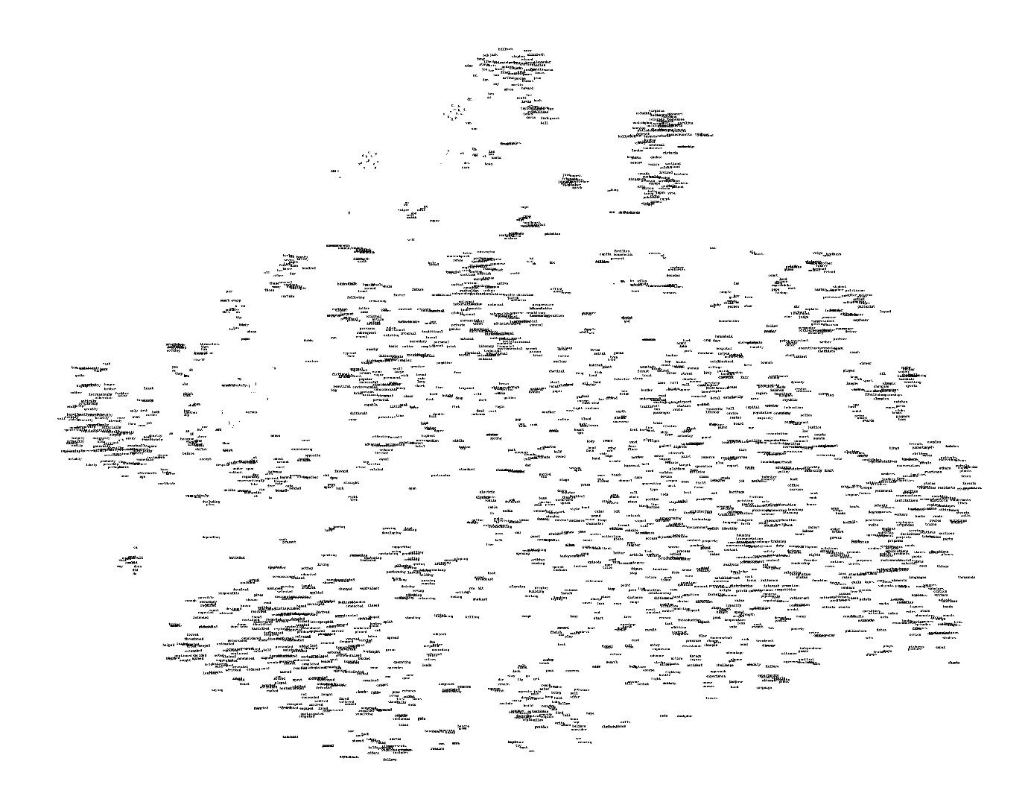
Visualizing Word Embeddings
Here we show the learned numeric representations (limited here to 2 dimensions) of many different vocabulary words
Too many words here to see! Let’s zoom in on a smaller section.
Notes:
Additionally, the embeddings of words with similar meanings will be very similar. So, when we visualize the embeddings, we find that words with similar meanings are close together. These embeddings have much more than two attributes – typically we allow them to have a few hundred attributes – but we can visualize them in 2d with PCA and other dimensionality reduction techniques.
Let’s zoom in…

Slide 15
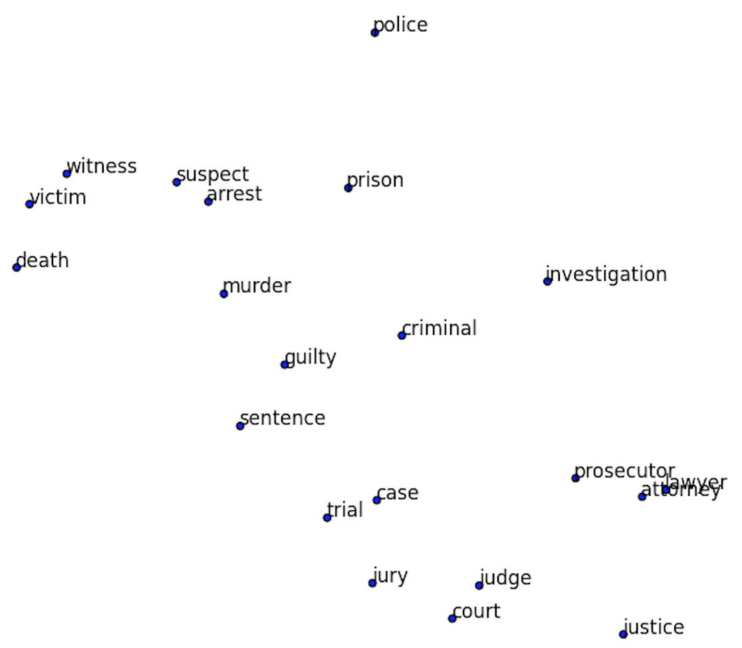
Visualizing Word Embeddings
If we zoom in on a small region of our word map, it’s all related words.
Note the similarity of all the words as a whole, but also of the individual neighbors.
“Lawyer” and “attorney” are right next to each other – they have almost identical characteristics!
Notes:
Here we have a small cloud of words that seem to be related to the legal system. They all have similar embeddings to some degree – they’re in the same cloud – but the words that are most closely related are closest together within the cloud. ’case’ and ‘trial’ are right next to each other – their attributes are almost identical. And ‘lawyer’ and ‘attorney’ are even closer – these words are almost synonymous

Slide 16
A brief note on how word embeddings are learned…
KEY IDEA: words are defined by the context in which they appear
A woman strolls down the street
A man strolls down the street
A child strolls down the street
A crocodile strolls down the street
A banana strolls down the street
A concept strolls down the street
Notes:
As mentioned at the beginning, we’ll see how word vectors are learned in the next lecture.
However, let’s take a moment to discuss the intuition behind that process.
The key idea behind the learning of word embeddings is that the meaning of words is defined by all the possible contexts in which they appear
The word ‘prosecutor’ can appear in almost all the same places where ‘lawyer’ might appear, but not all – there are some sentences where one is appropriate, but the other is not.
So, a good measure of how similar two words are is how often you can exchange one for the other in a sentence. This is what we mean by saying that words are defined by the possible contexts in which they appear.
The word ‘woman’ and ‘man’ both make sense in the vast majority of sentences in which they appear -- we can almost always exchange one for the other, and the sentence still makes perfect sense -- whereas the word ‘child’ and ‘man’ can be exchanged less often. There are some contexts in which both ‘crocodile’ and ‘man’ make sense – it still makes some sense to talk about a crocodile strolling down the street – but very rarely can we exchange ‘banana’, and we can almost never exchange the word ‘concept’: the meaning of these two words is very different, so the words around them will be quite different on average as well.

Slide 17
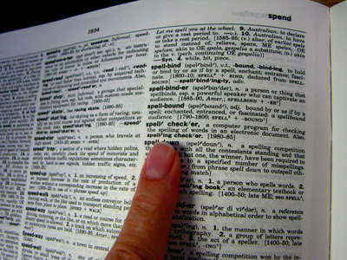
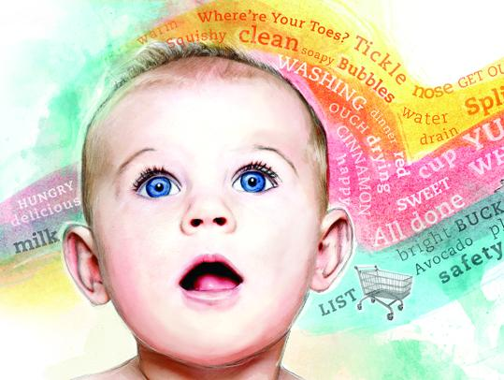
KEY IDEA: words are defined by the context in which they appear
-> if words are always exchangeable, they must have very similar meaning
https://www.parenting.com/activities/baby/teach-baby-to-talk/
learn word meaning like an adult:
explicit definitions
learn word meaning like an child:
implicit definitions from context
Notes:
For us, the easiest way to learn a new word is often with a dictionary, but our method of training the computer to understand words is more like the way a child learns them: it repeatedly observes words in context

Slide 18
A Very Simple Word Embedding-Based Model
Notes:
Setting aside the learn process for now, let’s see what we can do with word vectors – how we can use them in a predictive model

Slide 19
VSWEM Step 1: Convert sentence to vectors
Look up words individually to obtain their vectors
Construct a sequence of vectors
This is a sentence
Notes:
Let’s think back to our bag of words models from before. The key to these models -- the thing that made them different from other models we’ve considered – was our method for converting text to a vector of numeric features.
Now that we have word vectors, we’ll do this a little differently.
Let’s suppose we want to encode the sentence ‘this is a sentence’ as a vector of numeric features.
First, we’ll take the word ‘this’ and look up its word vector. In this example, all the word vectors have 6 attributes, but the word vectors we’ll end up using will have much more than this.
Then we look up the word vectors for ‘is’, ‘a’, and ‘sentence’: we’ve looked up the semantic attributes for all of these and placed them side by side.

Slide 20
VSWEM Step 1: Convert sentence to vectors
Sentence length
This is a sentence
Embedding length
Notes:
We’ve now converted our sentence into a grid of numeric attributes. The horizontal length of the grid is the number of words in our sentence, and the height of the grid is the number of attributes we’re using to describe each word – in other words, the height is the ‘dimension’ of our word vectors.
Now, to feed sentences into a predictive model, recall that we’ll need a representation for each possible sentence we might consider that’s always the same length. In the bag of words model, this length was the number of words in our vocabulary. But now, we can use summary statistics to give us a vector whose length is a multiple of the number of attributes in our word vectors.

Slide 21
VSWEM Step 2: Take the MAX over the sentence for each embedding dimension
This is a sentence
MAX
Notes:
As an example, let’s use two very simple summary statistics: the max, and the average.
First, let’s take the max value of our first attribute across the whole sentence.
If this attribute represented happiness, then the resulting value would be the highest happiness value found in any of the words in our sentence.

Slide 22
VSWEM Step 2: Take the MAX over the sentence for each embedding dimension
This is a sentence
MAX
Notes:
Then we’ll do the same for the second attribute. If this attribute represented singular vs plural, the result would tell us whether any of the words in our sentence are plural.

Slide 23
VSWEM Step 2: Take the MAX over the sentence for each embedding dimension
This is a sentence
MAX

Slide 24
VSWEM Step 2: Take the MAX over the sentence for each embedding dimension
This is a sentence
MAX
Notes:
We’ll do this for all six of our attributes.

Slide 25
VSWEM Step 2: Take the MAX over the sentence for each embedding dimension
This is a sentence
MAX

Slide 26
VSWEM Step 2: Take the MAX over the sentence for each embedding dimension
This is a sentence
MAX
Notes:
Until we have a vector of length six regardless of the size of the sentence we started with.

Slide 27
VSWEM Step 3: Take the AVERAGE over the sentence for each embedding dimension
This is a sentence
AVG
Notes:
We can do the same with our second summary statistic, the average.
The first resulting value will tell us how happy the words in our sentence are, on average.

Slide 28
VSWEM Step 3: Take the AVERAGE over the sentence for each embedding dimension
This is a sentence
AVG
Notes:
The second value will tell us how plural they are, on average.

Slide 29
VSWEM Step 3: Take the AVERAGE over the sentence for each embedding dimension
This is a sentence
AVG
Notes:
And so on – we take the average of the third attribute

Slide 30
VSWEM Step 3: Take the AVERAGE over the sentence for each embedding dimension
This is a sentence
AVG
Notes:
The fourth

Slide 31
VSWEM Step 3: Take the AVERAGE over the sentence for each embedding dimension
This is a sentence
AVG
Notes:
The fifth

Slide 32
VSWEM Step 3: Take the AVERAGE over the sentence for each embedding dimension
This is a sentence
AVG
Notes:
And the sixth, until we have a vector of length 6, the number of attributes, regardless of the number of words in our sentence.

Slide 33
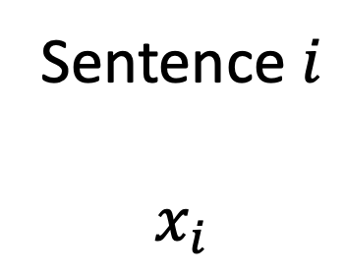
VSWEM Step 4: Concatenate MAX and AVG
max
This is a sentence
Sentence $i$
$$x_{i}$$
Question:
What information are we losing when we do this?
avg
Notes:
In the VSWEM approach, which stands for ‘very simple word embedding based model’, we take the max and average of each attribute across all words in the sentence, giving us two vectors that look much like word embeddings, but are pooling information across our entire sentence rather than representing just a single word. We can then concatenate these two vectors together – stack them, in other words, resulting in a feature vector that has the same length for every sentence we might consider. Its length is two times the number of attributes in our word vectors.
We can then use this vector to make predictions using logistic regression or any other prediction model.
What have we gained by using word vectors?
First, our feature vector is now much shorter than it was before, which makes the learning process easier and faster -- we have fewer parameters to learn. Previously, with the bag of words approach, it was the length of our vocabulary, which might be thousands of words. Second, our model now understands words in terms of their attributes rather than individual words in isolation, which allows it to make better predictions particularly for words it has not seen very often.
However, we still lose something with the VSWEM approach. When we took the max and average across our whole sentence, we lost information about distinct words, and about the order of the words in the sentence. It turns out these models tend to perform quite well despite this limitation. Nevertheless, in later lectures we’ll take a look at models designed specifically for sequential data – notably the recurrent neural network – that will allow us to overcome this limitation

Slide 34
Much more complex models…
Look up words individually to obtain their vectors
Construct a sequence of vectors
Then, apply an NN-based model designed for sequences (e.g. transformer, RNN)
This is a sentence
x_{i}
Notes:
However, these models tend to be much more complex than the bag of words and/or VSWEM setup.
Remember our rule of thumb: we prefer the simplest model that gets the job done.
When beginning an NLP project, it is advisable to start with a bag of words model, a VSWEM-like model, or both, and only then explore whether adding complexity improves the results.

Slide 35
State of the art NLP models have billions of parameters (up to 1T).
SYSTEM PROMPT (HUMAN-WRITTEN)
A train carriage containing controlled nuclear materials was stolen in Cincinnati today. Its whereabouts are unknown.
MODEL COMPLETION (MACHINE-WRITTEN, FIRST TRY)
The incident occurred on the downtown train line, which runs from Covington and Ashland stations.
In an email to Ohio news outlets, the U.S. Department of Energy said it is working with the Federal Railroad Administration to find the thief.
“The theft of this nuclear material will have significant negative consequences on public and environmental health, our workforce and the economy of our nation,” said Tom Hicks, the U.S. Energy Secretary, in a statement. “Our top priority is to secure the theft and ensure it doesn’t happen again.”
The stolen material was taken from the University of Cincinnati’s Research Triangle Park nuclear research site, according to a news release from Department officials.
The Nuclear Regulatory Commission did not immediately release any information.
According to the release, the U.S. Department of Energy’s Office of Nuclear Material Safety and Security is leading that team’s investigation.
“The safety of people, the environment and the nation’s nuclear stockpile is our highest priority,” Hicks said. “We will get to the bottom of this and make no excuses.
“Better Language Models and Their Implications”
2/14/19
OpenAI
Notes:
The current state of the art in NLP uses a kind of model called a transformer, which learns a deep hierarchy of semantic representations much like the ones we discussed in our computer vision block
GPT-3, developed by OpenAI, as seen in this example, and its successor, GPT-4, are trained on the whole internet, more or less, and the biggest models now have over a trillion parameters
Although the scale is incomprehensible, the principles involved in these models are quite simple
We’ll touch on these principles a little later on

Slide 36
With word vectors, methods for text vs sequences are similar: A sequence of word vectors…
This is a sentence
Notes:
Importantly, now that we can convert words to vectors, text data and time-series data become quite similar.
A sentence becomes a sequence of multiple numeric values – these numeric values are the different word attributes

Slide 37
With word vectors, methods for text vs sequences are similar: …now looks just like a sequence of measurements.
Day 1 Day 2 Day 3 Day 4
Temp
BP
HR
RR
SpO2
Glucose
Notes:
Time-series data are also sequences of multiple numeric values corresponding to multiple types of measurements captured in the ICU, for example.
There are differences between the two – for one thing, the words in a sentence don’t have a time associated with them. Still, this similarity allows us to use many methods for NLP for time-series as well, and vice-versa.

Slide 38
In this case, too, we can get a single numeric vector for our predictive models by taking a max and average (or any other summary statistics we’d like)
Day 1 Day 2 Day 3 Day 4
Temp
BP
HR
RR
SpO2
Glucose
Notes:
As a very simple example, we can use the same approach as we did in VSWEM when working with time series. If we want to use logistic regression or a simple MLP to make predictions, we need to reduce our time series to a vector that has the same length for every sequence in our dataset. We can do this by simply taking the max and average – or any other summary statistics, for that matter -- of every numeric value in the series, resulting in a fixed-length vector, as required for logistic regression or the MLP.
This is done quite often in practice – for example, this very approach was used to predict hypoxemia during anesthesia quite successfully.

Slide 39
But when we do this, we lose information about order.
Next time, we’ll talk about ways to overcome this limitation
Day 1 Day 2 Day 3 Day 4
Temp
BP
HR
RR
SpO2
Glucose
Notes:
Just like in the NLP example, we lose information that may be important when we do this; in particular, we lose information about the order of measurements.

Slide 40
Conclusions
Word vectors capture semantic attributes of words, allowing NLP models to make similar predictions for words with similar attributes
The key idea behind the learning of word vectors is that words are defined by the various contexts in which they appear
We explored a ‘very simple word embedding based model’, which makes predictions based on a summary of word attributes across an entire sentence of interest
A sequence of word vectors is very similar to a time series of numeric measurements, so we can use similar models (e.g. RNNs) for the two
Notes:
In conclusion,

Slide 41
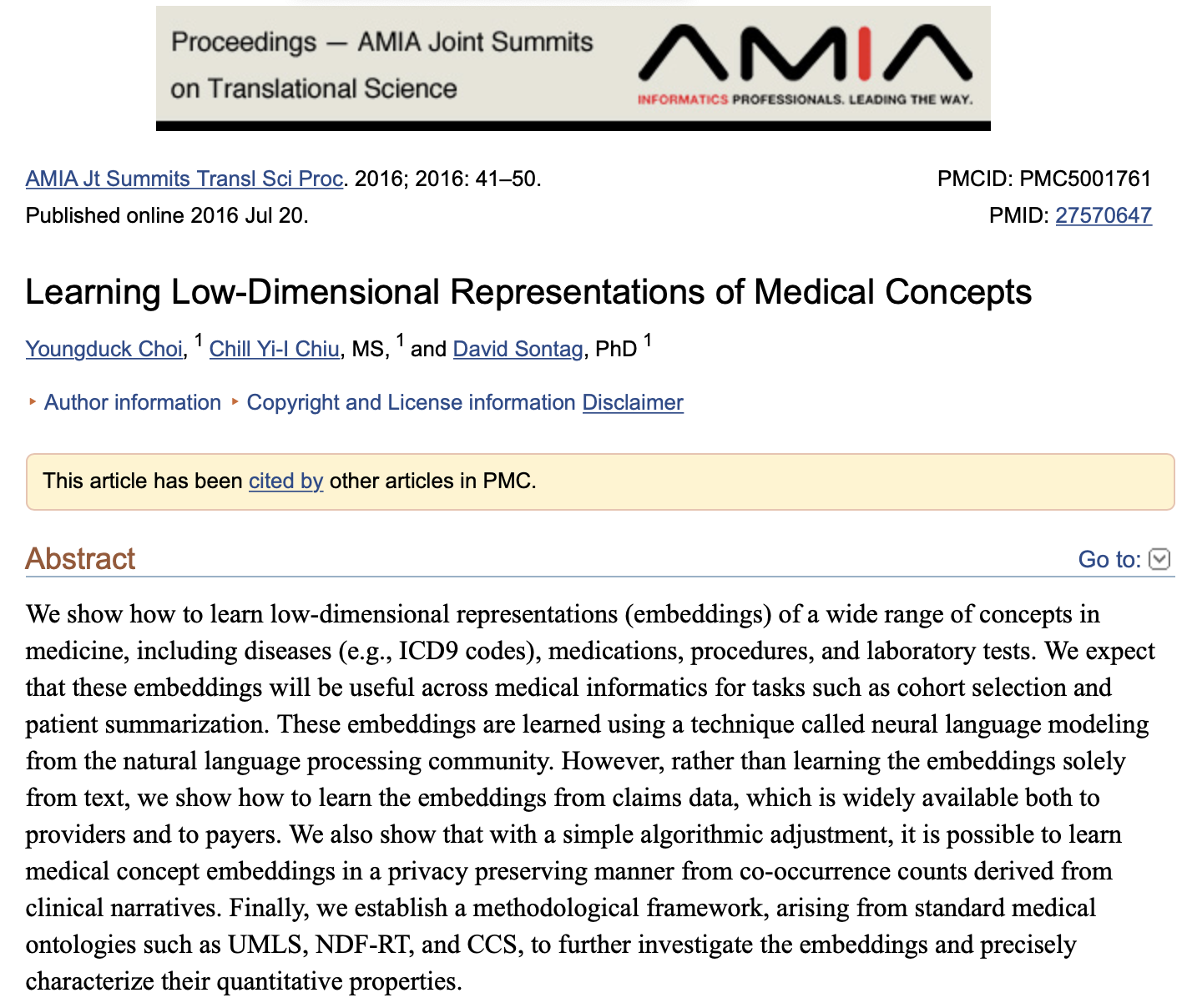
Bonus: we can also do this with categorical variables!
Locations (city/state)
Dx and procedure codes
Medical concepts
What attributes could be used to encode the meaning of medical concepts?
Notes:
It is worth noting that the idea of learning a compact set of attributes for words has also proved quite effective for other categorical variables with a large number of categories. If we consider diagnosis codes, for instance, many of the same considerations we’ve discussed still apply:
Some categories are more closely related to each other than others, and it is advantageous to understand these relationships when making predictions.
We might also argue that diagnosis and procedure codes, much like words, can also be defined in terms of the contexts in which they appear.
However, in this case the contexts are not sentences; instead, they are patients, each of whom defines a unique trajectory of health-related measurements and observations.

